Slide 1
Birch Meadow’s (Really Fun) Recorder Program
Overview and Live Demonstration of 3rd-5th grade Recorder, Ensemble and Notational Literacy Curriculum
- Mel Steiger, M.Ed, M.Curriculum & Instruction, B. Music Ed.

Slide 2
This is a recorder
HI

Slide 3
Why do we learn to play the recorder in 3rd, 4th and 5th grade?
It’s a really big part of our curriculum and helps us learn to work together to play in a group- or ensemble
It helps us learn to read music and apply that skill immediately
Its fun!

Slide 4
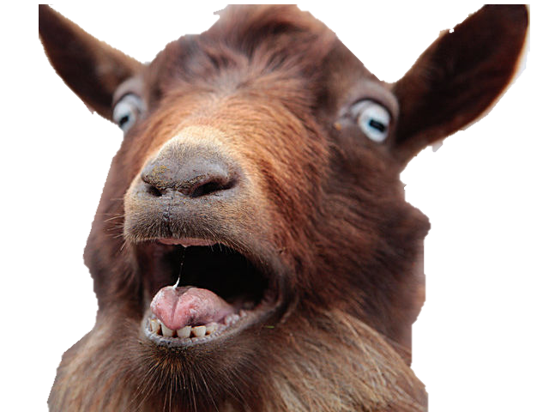
This is what most people think of when imagining the sounds a recorder makes…

Slide 5
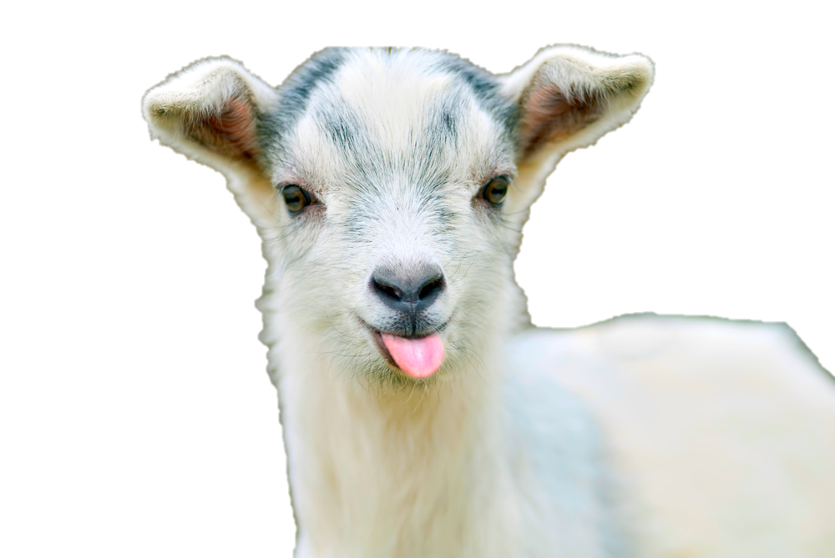
But it doesn’t have to be that way!
Recorders SHOULD sound beautiful with an even tone- they SHOULD be a pleasant listening ( and playing) experience.
To Achieve this, we start working on how we SOUND in 3rd grade

Slide 6
Step 1: Breath Control
We learn to control our breath using “too” breath.
This helps us to articulate the notes!
We don’t even earn the right to use the whole recorder until we master this skill… we only get the head joint!

Slide 7
Reading Rhythms with our breath
Students use “Too” breath to articulate each note

Slide 8
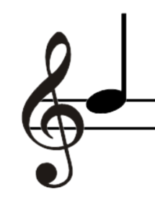
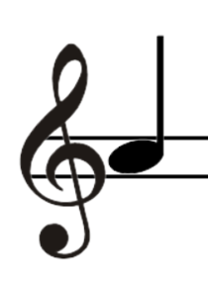
Step 2: Learn Line Vs. Space, 1 vs 2
Modified Musical Staff
Focus on opposites
Line Vs. Space
1 fingers vs 2
B Vs A

Slide 9
Step 3: Add More Notes!

Slide 10
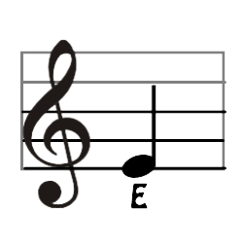
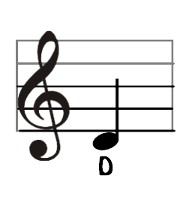
Step 4: Add EVEN MORE NOTES
Add in new notes!
Expand our repertoire
Play common folk songs

Slide 11
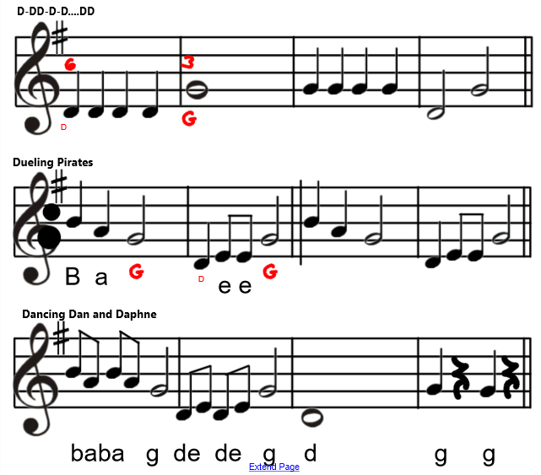
Step 6: Add More Measures
Keep pushing what we can accomplish!
Point out form, dynamics etc..
Harder mixes of notes and rhythms
“Bust Through” brick walls to add length

Slide 12
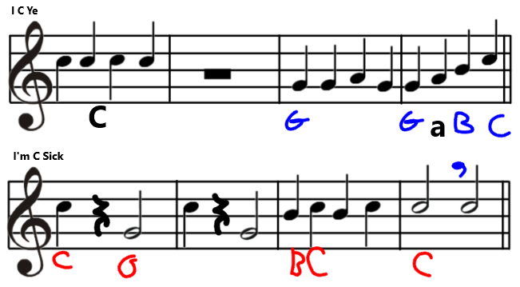
Step 7… BREAK ALL THE RULES
Start skipping holes!
Remove our thumbs!
Tie notes together!
Decode Errors

Slide 13
Step 8: Add Harmony
Start playing music with more than one part
Have students start working more independently
Have students start writing music
Add in extra spicy notes like F# and C#

Slide 14
Spring Rain
C
O
D
A
A
B
A
C
A

Slide 15
Spring Rain
Two-Part Recorder Piece in Rondo Form

Slide 16
Thank you for being here!
This concludes our recorder presentation!

